Slide 1


Sales Insights - Data Analysis Project using Tableau
By – Prabhash Kumar
https://github.com/Prabhashg
https://www.linkedin.com/in/prabhash-kumar-405648201

Slide 2
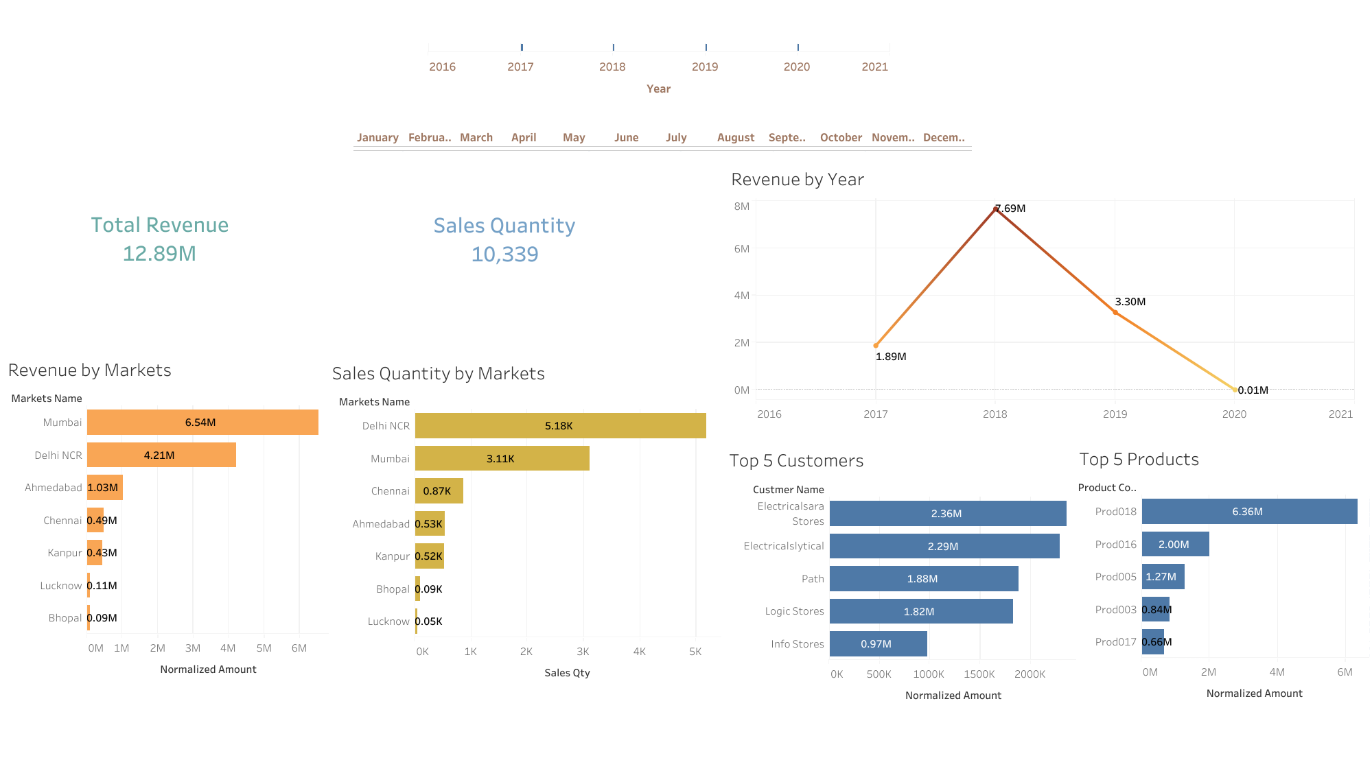

Slide 3
